Slide 1
Red Lake Margaret Cochenour Memorial Hospital
Our Vision
Working together towards excellence in Northern Healthcare
Our Mission
Compassionate, quality care – every patient, every time

Slide 2
Our Values
Keeping Our Word
Speaking Up for Our Patients and Community
Respect
Working Together
Being Inclusive

Slide 3
Our Priorities
Access
Helping patients and families get the care they need
Quality
Providing quality, evidence-informed, physically, psychologically and culturally safe care
Caring
System Leadership & Innovation
Contributing leadership and innovation to our healthcare system
Sustainable Infrastructure
Managing our resources responsibly

Slide 4
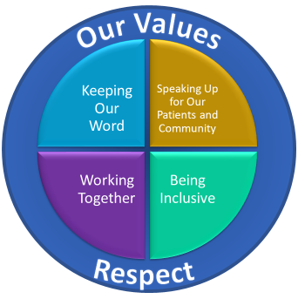
Red Lake Margaret Cochenour Memorial Hospital
Strategic Plan 2020-2023 Summary
Our Vision: Working Together Towards Excellence in Northern Healthcare
Our Mission: Compassionate, Quality Care – Every Patient, Every time
Our 2020-23 Priorities
Priorities | Quality | Access | Team | System Leadership and Innovation | Sustainable Infrastructure
Goals | To provide quality, evidence-informed, physically, psychologically and culturally safe care | To help patients and families get the care they need | To value each other | To contribute leadership and innovation to our healthcare system | To manage our resources responsibly
Objectives | Improving Indigenous Patient experience Improving overall patient experience Meeting our Quality Improvement Plan Mental Health and Palliative Care targets Achieving Lab, Pharmacy and overall accreditation | Increasing care access through virtual visits Participating in initiatives to improve access to care. Reducing 30-day readmission rates for selected conditions | Decreasing turnover Continue improving staff satisfaction Decreasing the number of violence-related incidents in our workplace Increasing the number of primary and secondary school students directly informed about healthcare careers | Partnering to innovate and improve healthcare delivery in our region and province | Achieving our fiscal targets Maintaining Information Technology system availability Maintaining Cybersecurity

